Slide 1
Getting started
Guide for users
First steps and beyond
Would you prefer a video or detailed help?
Simply scan the QR codes
April 9, 2024

Slide 2
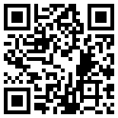
Install Olvid.
Download Olvid from your device's store
OR
Scan this QR code with your camera to find Olvid in your device's store.
Olvid works without a phone number, and is available free of charge with all compatible devices.

Slide 3
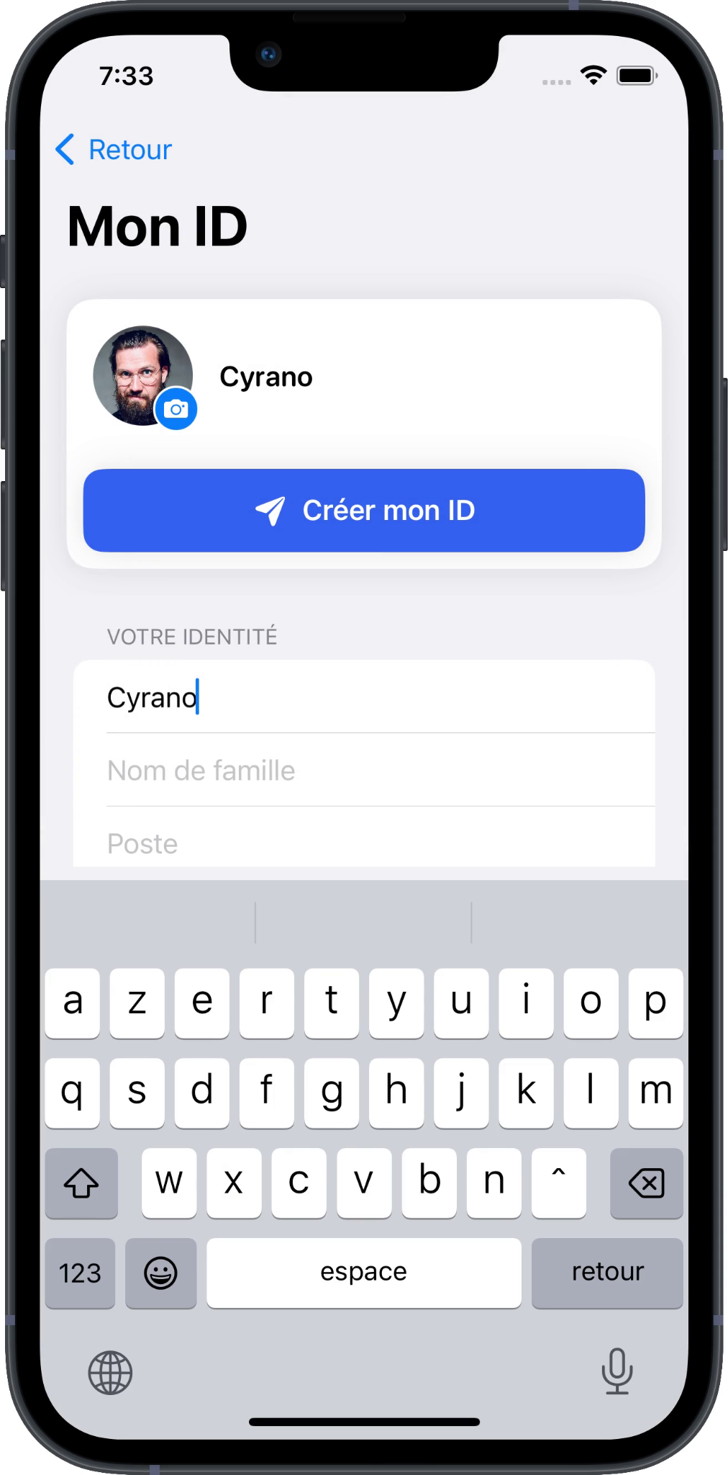
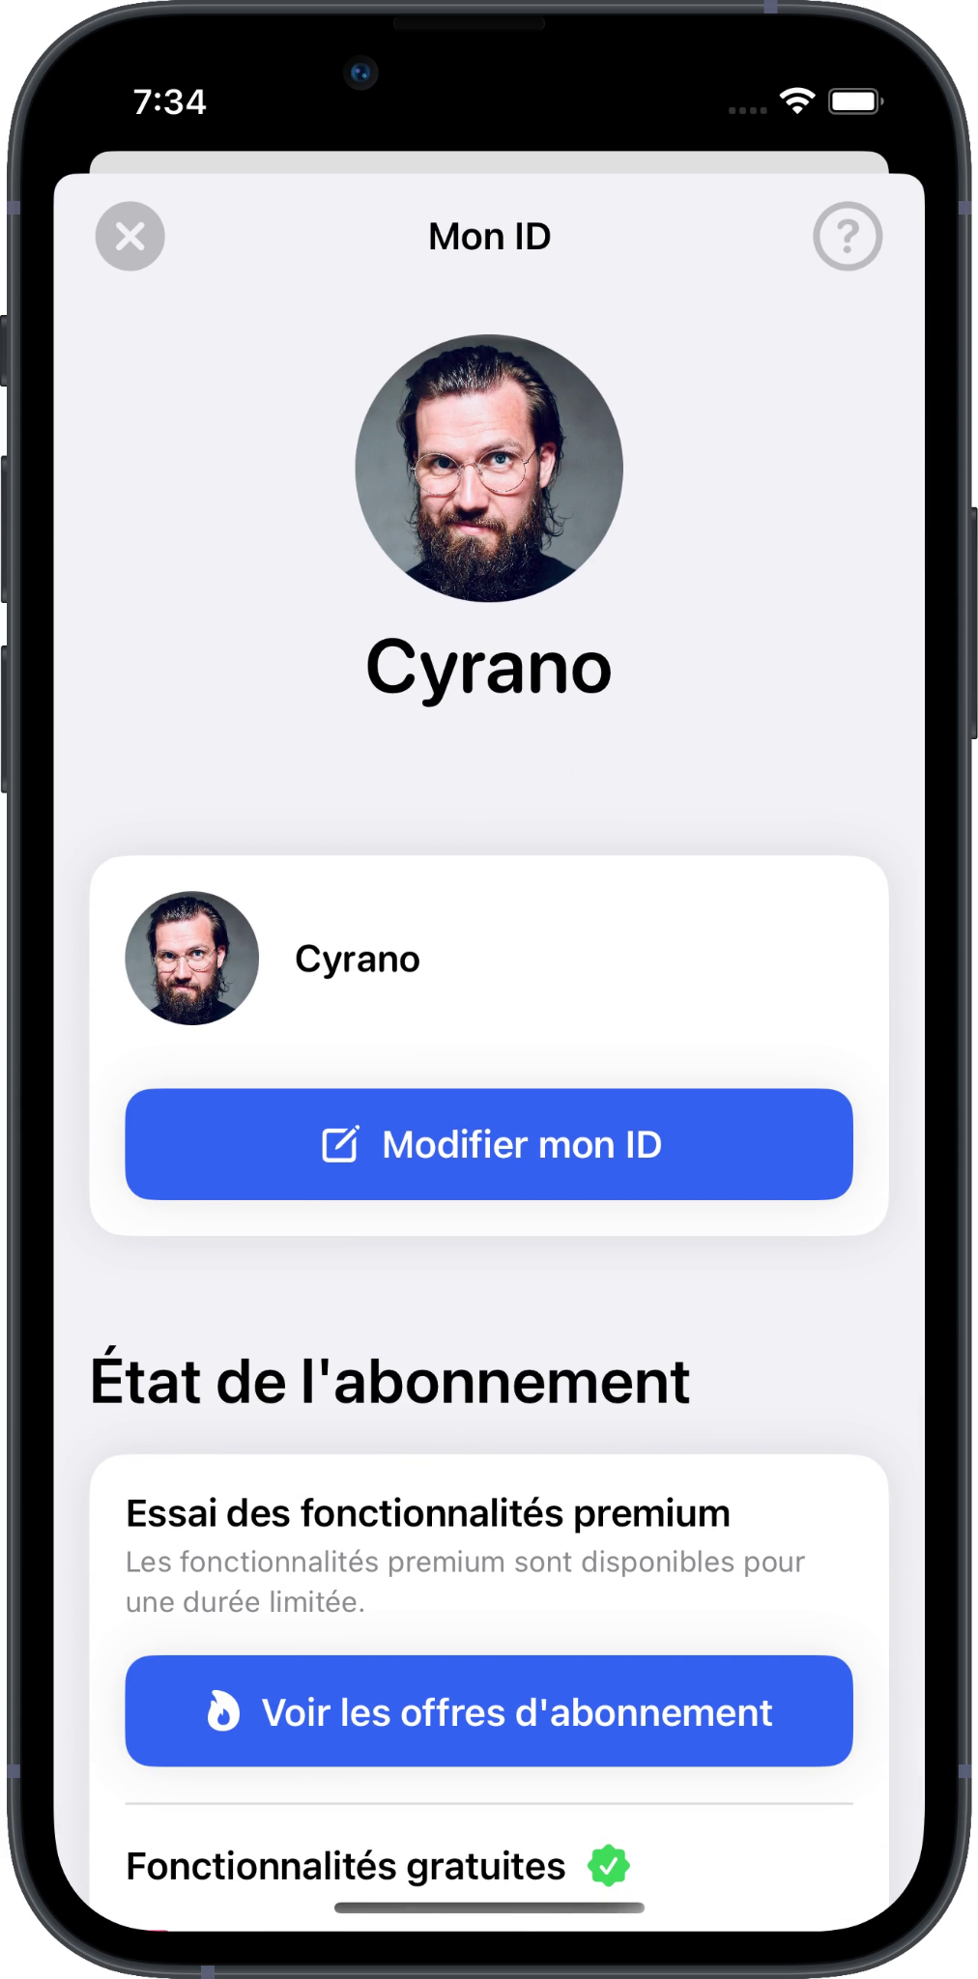
Create your Olvid profile.
Create your first Olvid profile if you've never used Olvid before.
Otherwise, restore a backup of your Olvid profiles.
Any information you enter into Olvid remains exclusively on your devices and those of your contacts. You never create an account with Olvid.
You can always update it later.

Slide 4
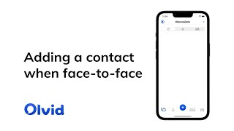

Slide 5
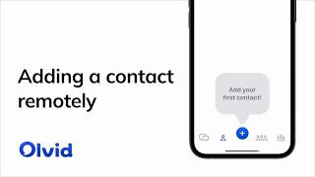

Slide 6
Introduce your contacts to each other.

Slide 7
Tap
Tap Directory.
Tap the search box. The contacts appear.
Tap the name of the contact you want to add.
Confirm by Tapping Add to contacts. A secure channel is created.
Tap Chat.

Slide 8
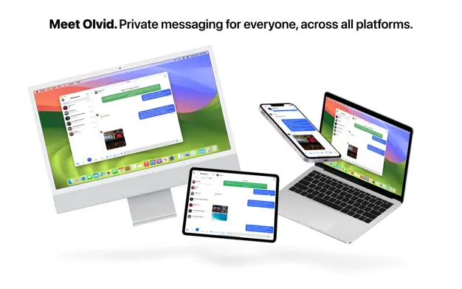
Olvid Desktop. Using Olvid with a computer.
You can use your Olvid profiles on several devices simultaneously: mobiles, tablets, Windows, macOS and Linux computers...
This makes it much easier to re-import them to your other devices, in case you change of phone or computer.

Slide 9
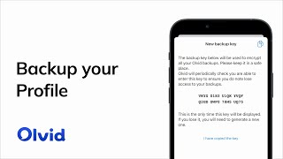
Backup your profiles now!
In anticipation of a change or loss of device, only a backup of your Olvid profiles with your original device will allow you to restore them on your next device.
Then backup your profile now!
Or also use Olvid on macOS, Windows or Linux.

Slide 10
Olvid Support.
Support-FAQ
Manuals
Contact Olvid Support
For any questions afterwards
feedback@olvid.io

